Slide 1

Decision Tree & Random Forest Tree

Slide 2
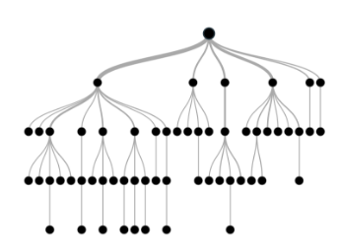
Decision Tree
A supervised Learning Algorithm
Consists of root node, decision node and lead node
Three steps to consider:
In which feature to split
How to split on the selected features
When to stop

Slide 3
Common Metrics for Split
Classification
Gini impurity
Information gain
Regression
Mean square error

Slide 4
Example: Gini impurity
Feature value (X1) | Class (Y)
1 | A
2 | B
3 | A
4 | B
5 | B
6 | A
If split at 3.5, there will be two nodes
Before split:
P(A) = 0.50, P(B) = 0.50
After split:
Node 1: A, B, A. P(A) = 0.67, P(B) = 0.33
Node 2: B, B, A. P(A) = 0.33, P(B) = 0.67
Gini impurity (gain)
Before: (all nodes) P(A) * (1-P(A)) + P(B) * (1-P(B)) = 0.5*0.5+0.5*0.5=0.5
After: (% node 1) P(A) * (1-P(A)) + P(B) * (1-P(B)) + (% node 2) P(A) * (1-P(A)) + P(B) * (1-P(B)) =
0.5 * (0.67 * 0.33 + 0.33 * 0.67) + 0.5 * (0.33 * 0.67 + 0.67 * 0.33) = 0.4422

Slide 5
Example: Information gain
Feature value (X1) | Class (Y)
1 | A
2 | B
3 | A
4 | B
5 | B
6 | A
If split at 3.5, there will be two nodes
Before split:
P(A) = 0.50, P(B) = 0.50
After split:
Node 1: A, B, A. P(A) = 0.67, P(B) = 0.33
Node 2: B, B, A. P(A) = 0.33, P(B) = 0.67
Information gain
Before: -P(A) * log(P(A)) - P(B) * log(P(B)) = - 0.5 * log(0.5) – 0.5 * log(0.5) = 0.693
After: (% node 1) -P(A) * log(P(A)) - P(B) * log(P(B)) + (% node 2) -P(A) * log(P(A)) - P(B) * log(P(B)) =
0.5 * (-0.67 * log(0.67) - 0.33 * log(0.33) -0.67 * log(0.67) - 0.33 * log(0.33)) = 0.634

Slide 6
Example: where to split? (use Gini)
X1 | Y
1 | A
2 | B
3 | A
4 | B
5 | B
6 | A
Split can happen on: 1.5, 2.5, 3.5, 4.5, 5.5. Before split: P(A) = 0.50, P(B) = 0.50
 | Node 1 & 2 |  | Gini 1 & 2 | Total Gain
1.5 | PA=1.0,PB=0.0, N=1 | PA=0.4,PB=0.6, N=5 | 1/6 * 0 + 5/6 * 0.48 = 0.40 | 0.5 – 0.4 = 0.1
2.5 | PA=0.5,PB=0.5, N=2 | PA=0.5,PB=0.5, N=4 | 2/6 * 0.5 + 4/6 * 0.5 = 0.5 | 0.5 – 0.5 = 0
3.5 | PA=2/3,PB=1/3, N=3 | PA=1/3,PB=2/3, N=3 | 3/6 * 0.44 + 3/6 * 0.44 = 0.44 | 0.5 - 0.44 = 0.06
4.5 | PA=0.5,PB=0.5, N=4 | PA=0.5,PB=0.5, N=2 | 4/6 * 0.5 + 2/6 * 0.5 = 0.5 | 0.5 – 0.5 = 0
5.5 | PA=0.4,PB=0.6, N=5 | PA=1.0,PB=0.0, N=1 | 5/6 * 0.48 + 1/6 * 0 = 0.40 | 0.5 – 0.4 = 0.1

Slide 7
Example: where to split? (use Gini)
X1 | Y
1 | A
2 | B
3 | A
4 | B
5 | B
6 | A
Split can happen on: 2.5, 3.5, 4.5, 5.5. Before split: P(A) = 0.40, P(B) = 0.60 => Gini = 0.48
 | Node 1 & 2 |  | Gini 1 & 2 | Total Gain
2.5 | PA=0.0,PB=1.0, N=1 | PA=0.5,PB=0.5, N=4 | 1/5 * 0.0 + 4/5 * 0.5 = 0.4 | 0.48 – 0.4= 0.08
3.5 | PA=0.5,PB=0.5, N=2 | PA=1/3,PB=2/3, N=3 | 2/5 * 0.5 + 3/5 * 0.44 = 0.464 | 0.48 - 0.464 = 0.016
4.5 | PA=1/3,PB=2/3, N=3 | PA=0.5,PB=0.5, N=2 | 3/5 * 0.44 + 2/5 * 0.5 = 0.464 | 0.48 - 0.464 = 0.016
5.5 | PA=1/4,PB=3/4, N=4 | PA=1.0,PB=0.0, N=1 | 4/5 * 0.375 + 1/5 * 0 = 0.3 | 0.48 – 0.3 = 0.18

Slide 8
Example: where to split? (use Gini)
X1 | Y
1 | A
2 | B
3 | A
4 | B
5 | B
6 | A
Split can happen on: 2.5, 3.5, 4.5. Before split: P(A) = 0.25, P(B) = 0.75 => Gini = 0.375
 | Node 1 & 2 |  | Gini 1 & 2 | Total Gain
2.5 | PA=0.0,PB=1.0, N=1 | PA=1/3,PB=2/3, N=3 | 1/4 * 0.0 + 3/4 * 0.44 = 0.33 | 0.375 – 0.33= 0.045
3.5 | PA=0.5,PB=0.5, N=2 | PA=0.0,PB=1.0, N=2 | 2/4 * 0.5 + 2/4 * 0.0= 0.25 | 0.375 – 0.25= 0.125
4.5 | PA=1/3,PB=2/3, N=3 | PA=0.0,PB=1.0, N=1 | 3/4 * 0.44 + 1/4 * 0.0 = 0.33 | 0.375 – 0.33= 0.045

Slide 9
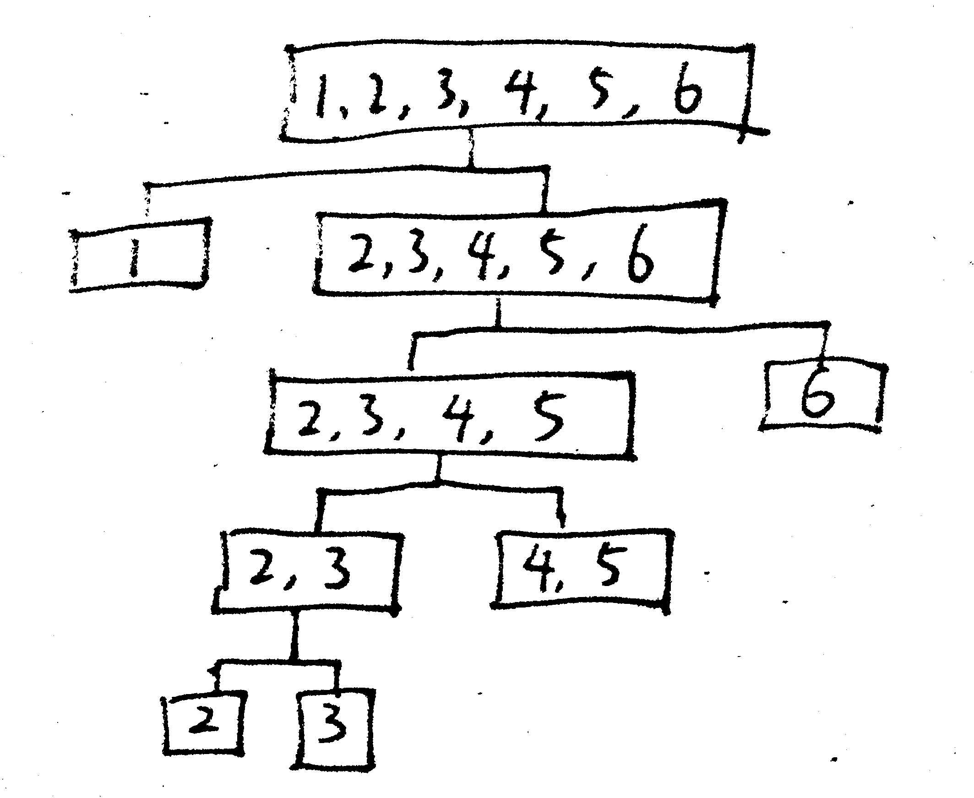
Example: decision tree result
Feature value (X1) | Class (Y)
1 | A
2 | B
3 | A
4 | B
5 | B
6 | A

Slide 10
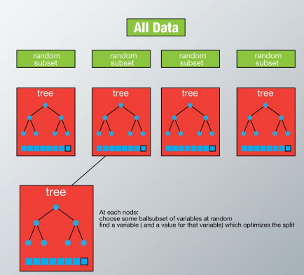
Random Forest Tree
Ensemble Model of Decision Trees
Randomly select subset of datasets and features when training a tree
Average the results from all the trees

Slide 11

Demo of Decision Tress & Random Forest

